Slide 1
Case Study:Personalized Cancer Diagnosis
Group-2
Member1: Nazmus Shadat Shohan
Member2: Tasfia Zaman Raisa
Member3: Muzahidul Islam
Member4: Sazzad Hossain
Member5: Roksana Yeasmin
Member6: Masudur Rahman

Slide 2
Tumors infographics
Frequent types of tumors
Lung
Oesophagus
Breast
Lung
Colorectal
Stomach
Uterus
Prostate

Slide 3
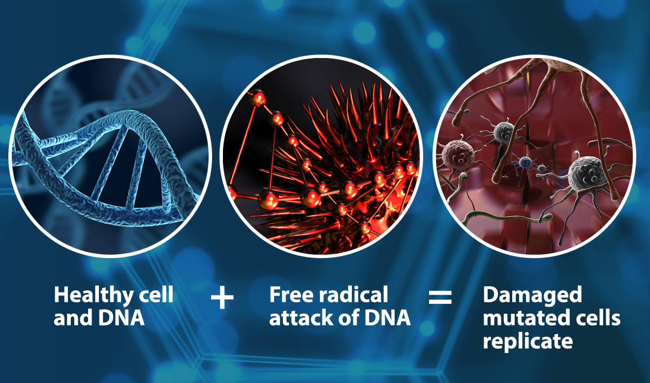
What is Cancer?
Normally, a cell divides and makes a perfect copy of itself, called DNA.
Once in a while,the DNA gets damaged.
Therefore,cell doesn’t listen to body anymore.
It keeps dividing and creates tumor.
Causes cancer periodically.

Slide 4
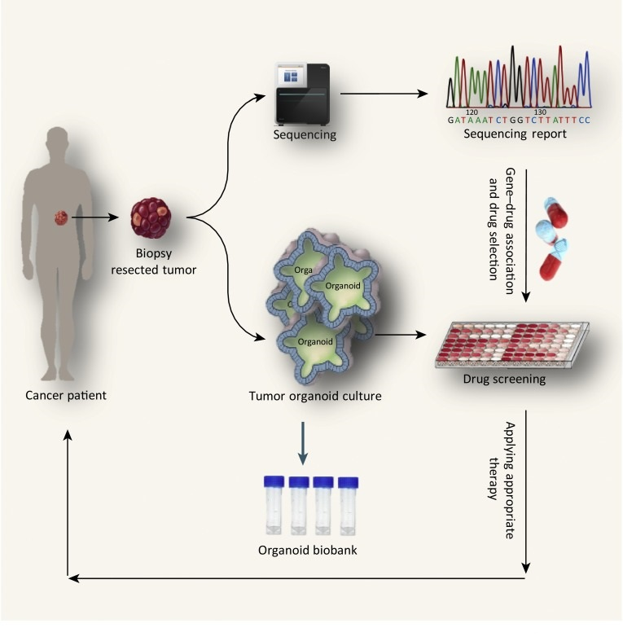
How cancer is diagnosed?
A tumor sample from the patience is collected.
Genetic sequencing of DNA is collected.
A tumor can have thousands of genetic mutations.
Mutation is a small change in a gene which causes cancer.
We have to classify with the help of gene and its variations.
There are 9 types of classification and some classes belong to cancer.

Slide 5
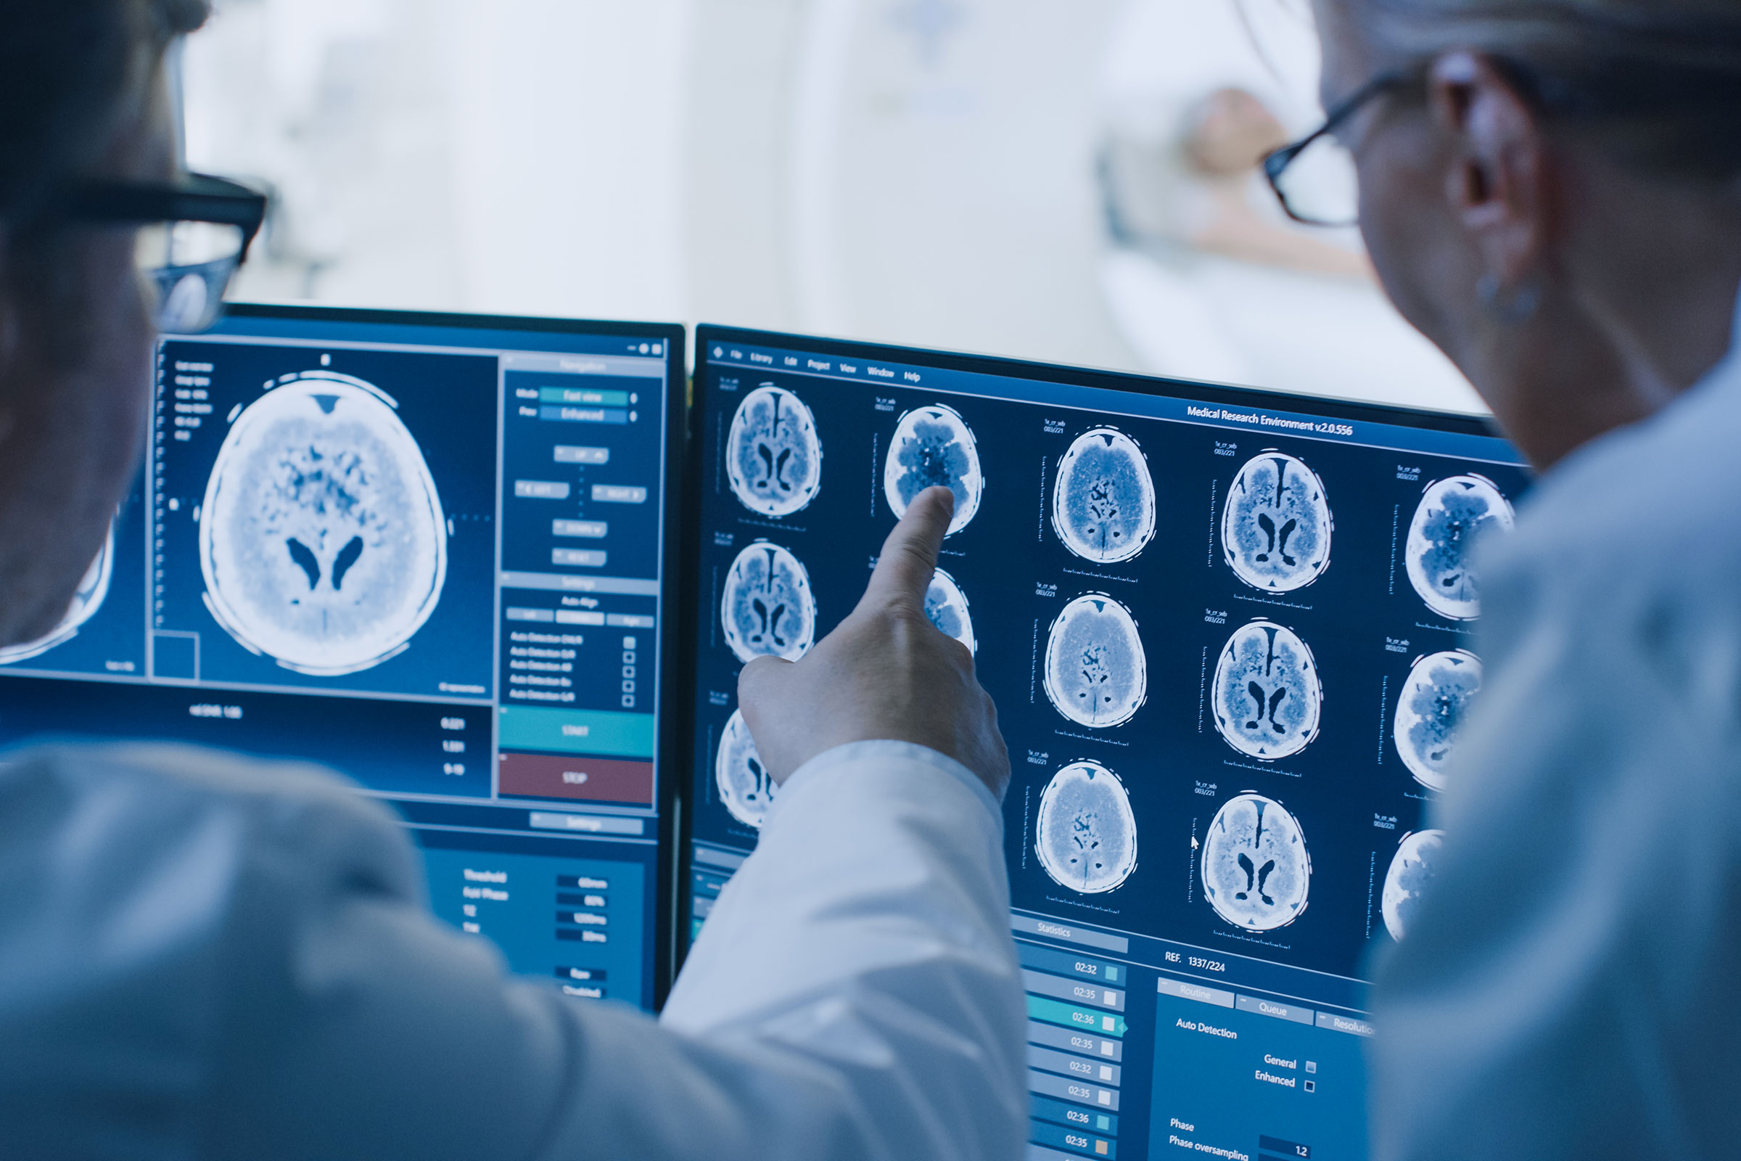
How cancer is diagnosed trivially?
A molecular pathologist selects a list of genetic variations of interest the needs to be analyzed.
He searches for evidence in the medical literature that somehow are relevant to the genetic variations of interest
Finally,a huge amount of time is spent analyzing the evidence related to each of the variations to classify

Slide 6
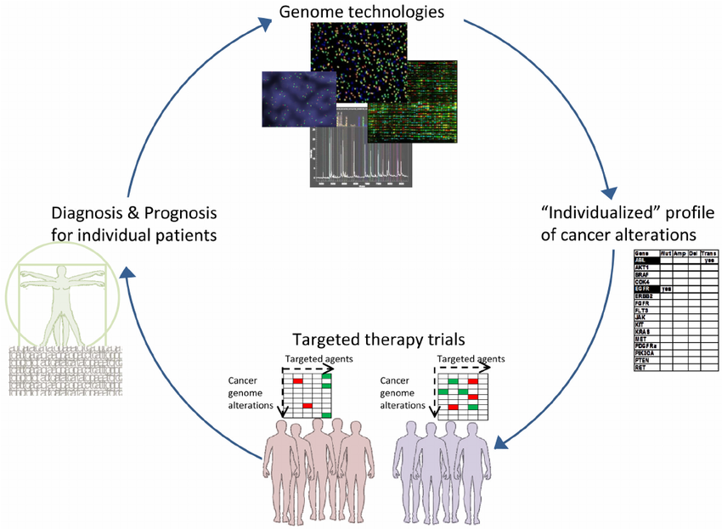
Personalized Cancer diagnosis
Problem-Statement: Classify generic variations based on evidence from the text-based clinical literature or research papers.
Goal: Reducing time for analyzing the evidence related to each of the variations to classify.
Solution: Implementation of machine learning models to classify the genetic variations into 9 classes.

Slide 7
Machine learning approach to solve problem
Objective: Predict the probability of each data point belonging to each of the 9 classes.
Algorithms Used: Naive Bayes,Logistic Regression, Support Vector Machine,Random Forest, Stocking Classifier.
Dataset Link:https://www.kaggle.com/c/msk-redefining-cancer-treatment/data
Performance Metrics:Multi class Log-Loss,Confusion matrix.

Slide 8
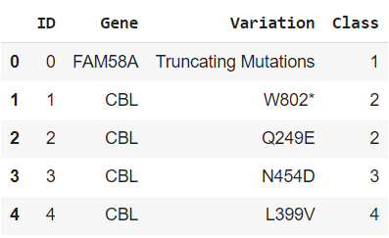
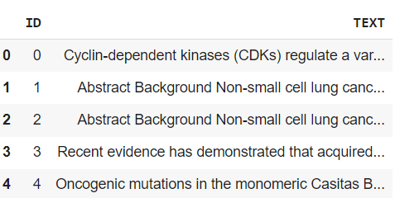
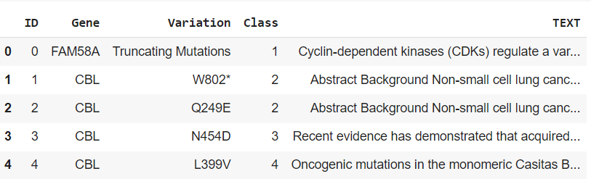
Datasets and Preprocessing
Training_Variants
Training_Text
Merging dataset

Slide 9
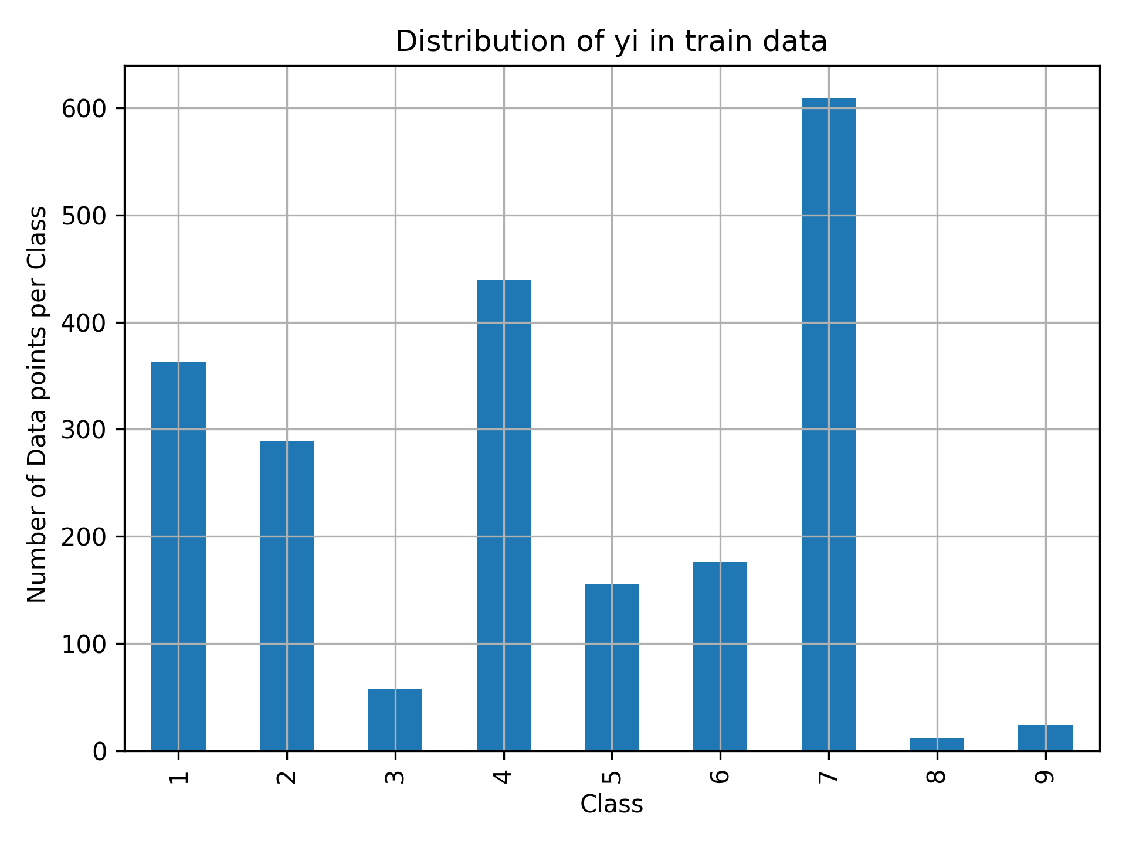
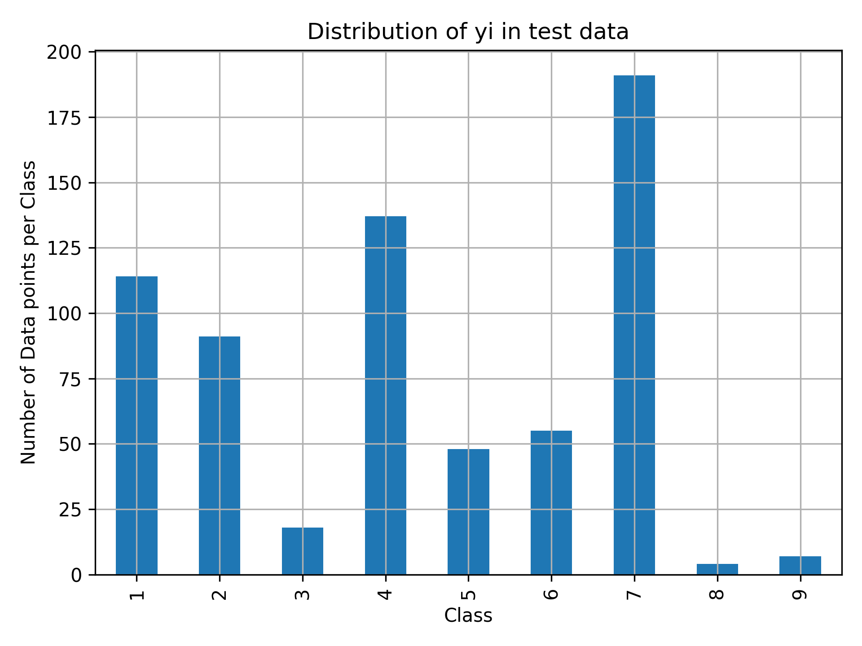
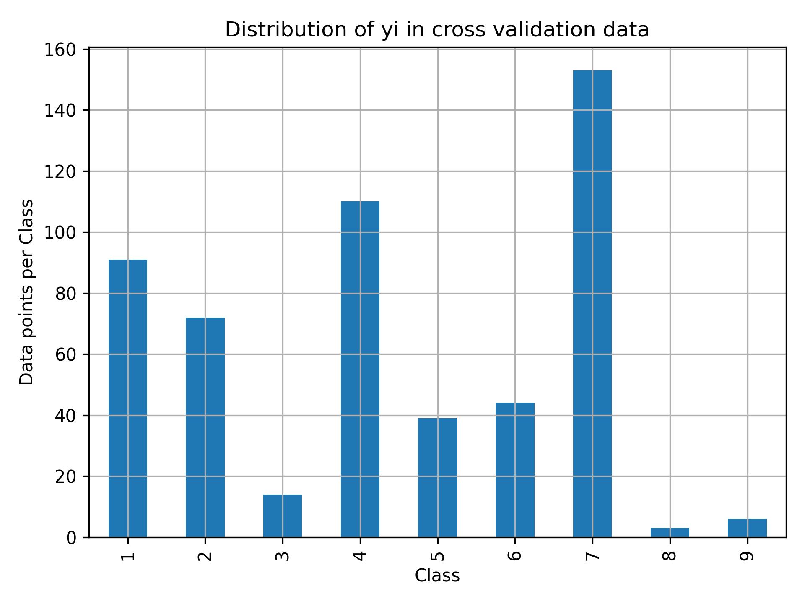
Distribution of classes
Distribution of training dataset
Distribution of testing dataset
Distribution of validation dataset

Slide 10
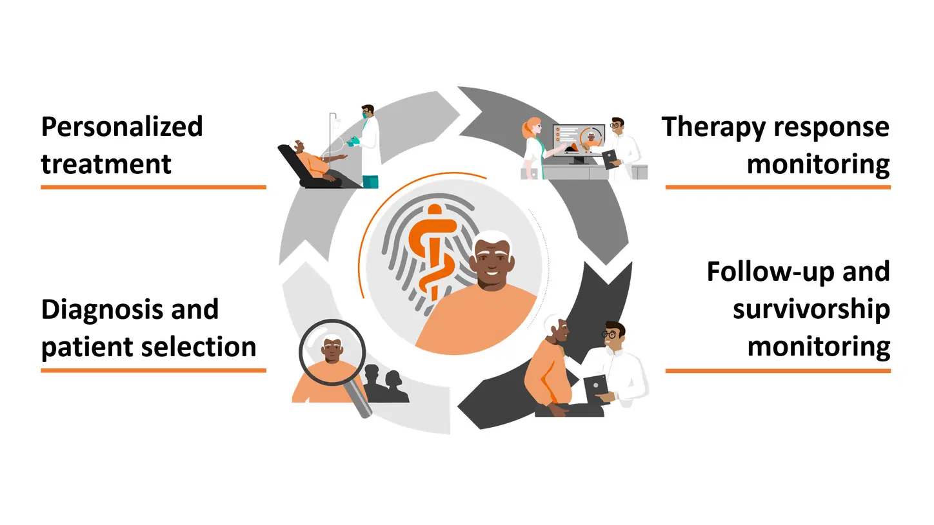
what is personalized cancer diagnosis?
Personalized cancer diagnosis, also known as precision oncology, is an approach to cancer diagnosis and treatment that takes into account the unique genetic and molecular characteristics of an individual's cancer. It involves tailoring medical decisions, including diagnosis, treatment selection, and therapy management, based on the specific genetic mutations, gene expression patterns, and other molecular alterations found in a patient's tumor.

Slide 11
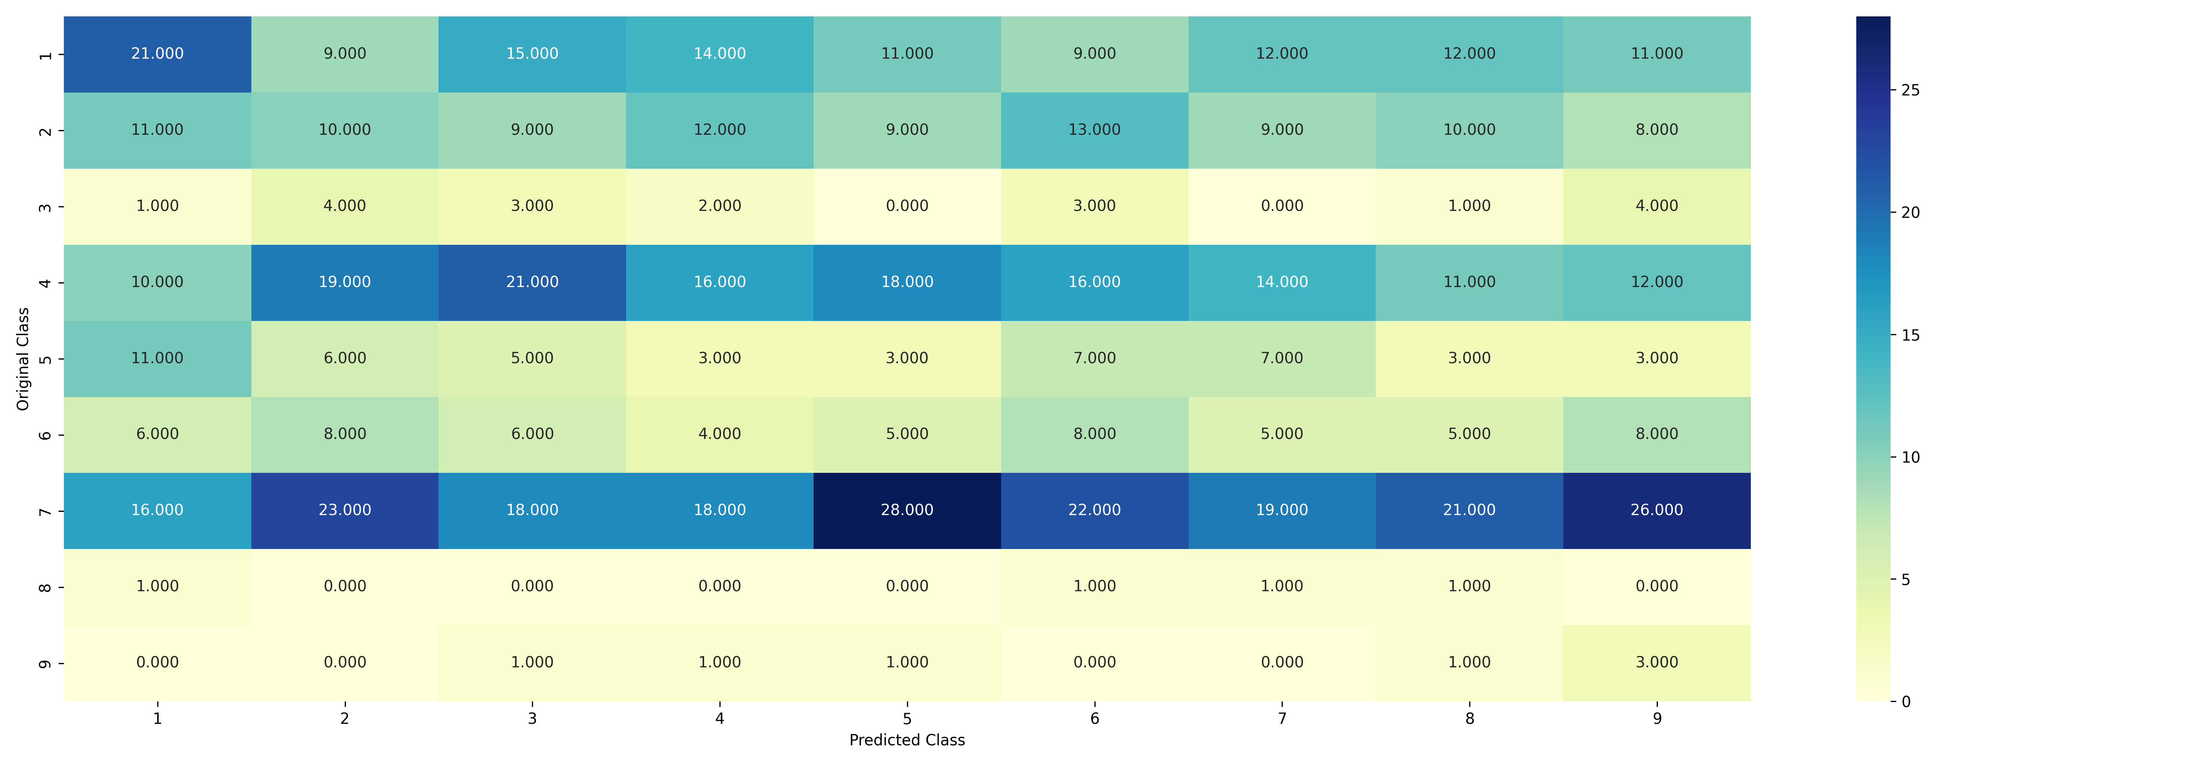
Evaluation of Random Model(Confusion Matrix)

Slide 12
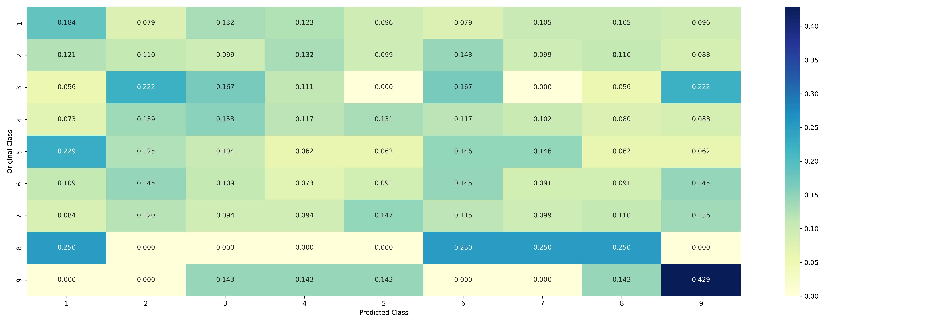
Evaluation of Random Model(Recall Matrix)

Slide 13
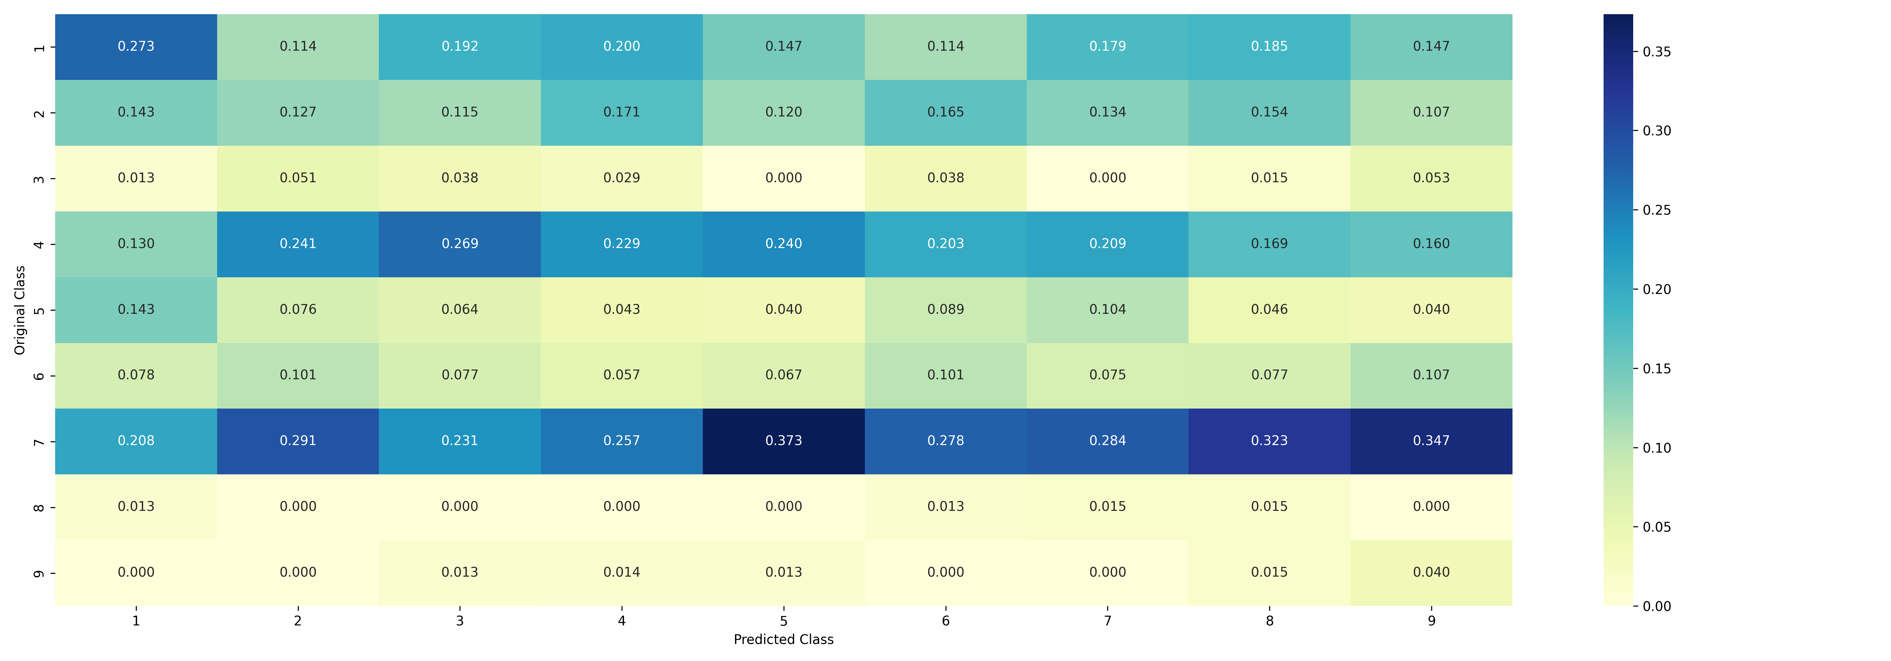
Evaluation of Random Model(Precision Matrix)

Slide 14
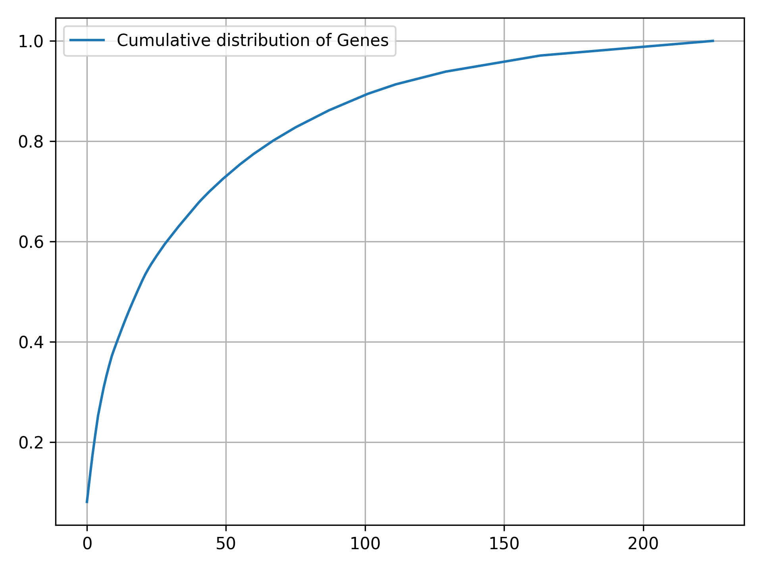
Evaluation of Gene Column(Cummulative Distribution)

Slide 15
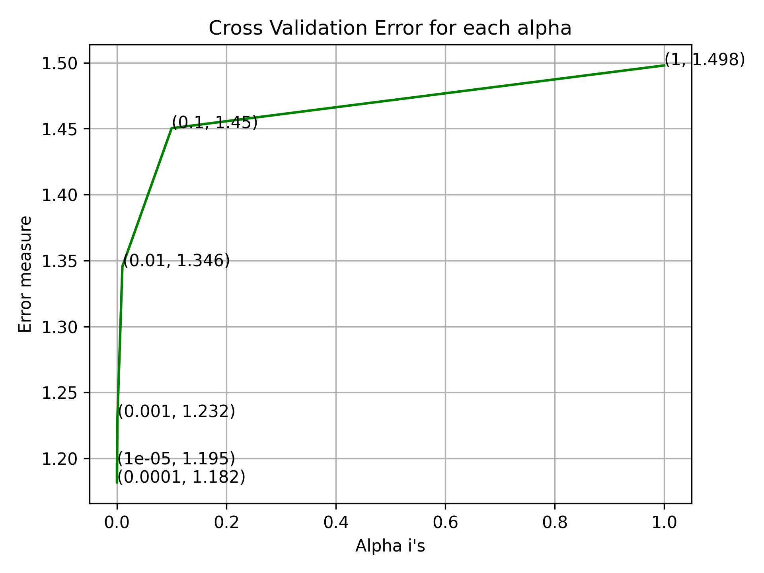
Evaluation of Gene Column(Error Analysis)

Slide 16
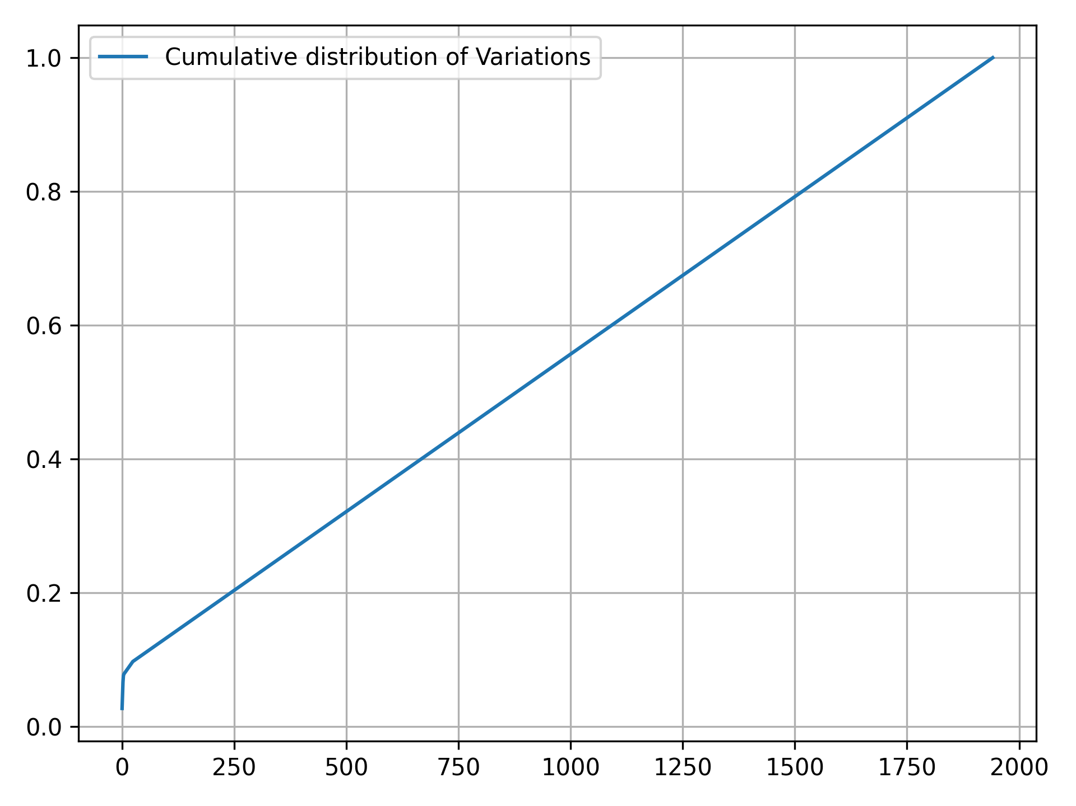
Evaluation of Variation Column(Cummulative Distribution)

Slide 17
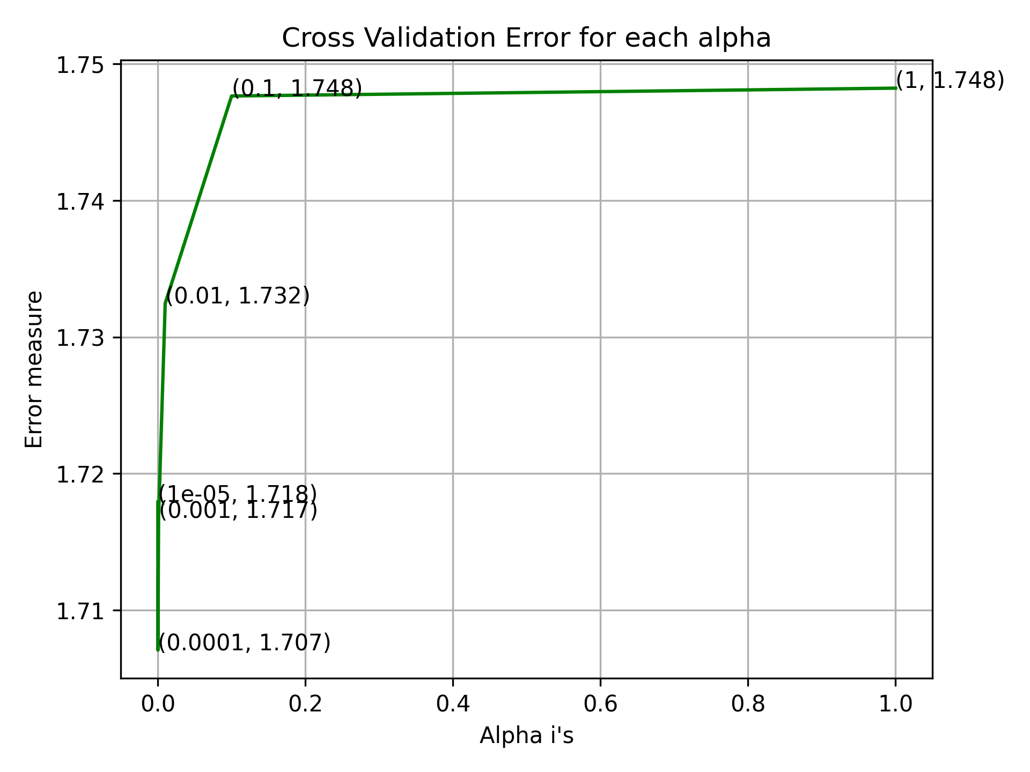
Evaluation of Variation Column(Error Analysis)

Slide 18
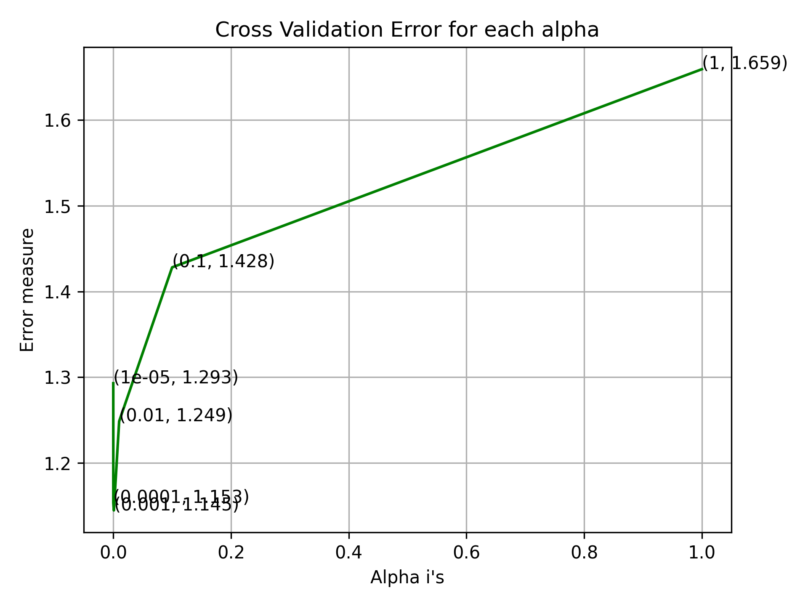
Evaluation of Text Column(Error Analysis)

Slide 19
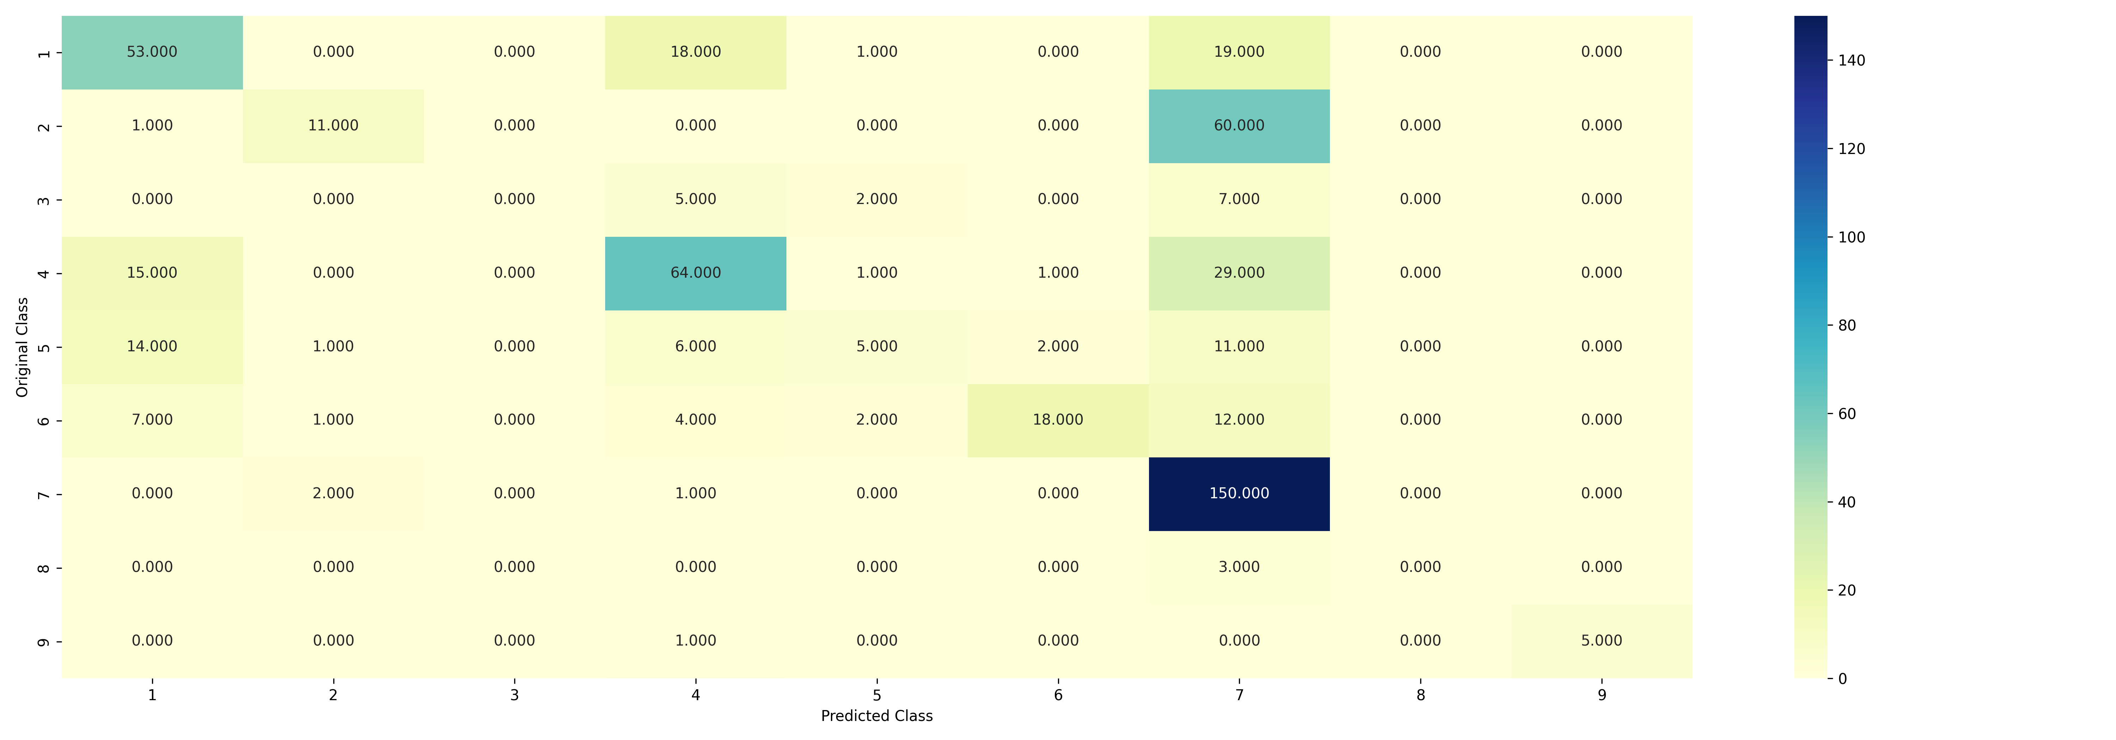
Evaluation of Naïve Bayes Model(Confusion Matrix)

Slide 20
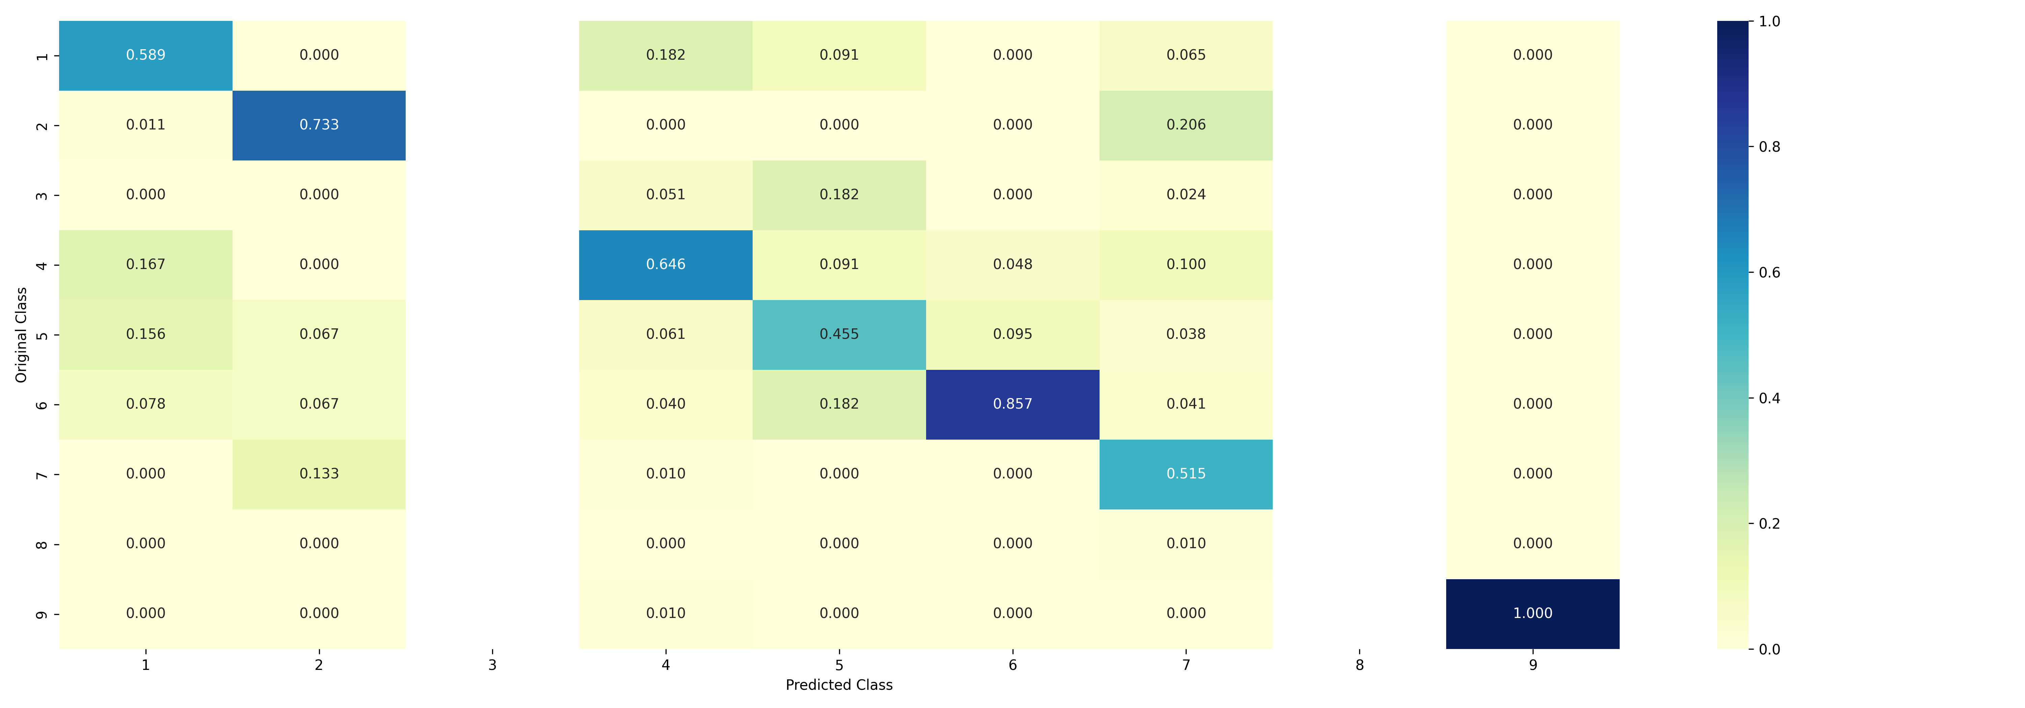
Evaluation of Naïve Bayes Model(Precision Matrix)

Slide 21
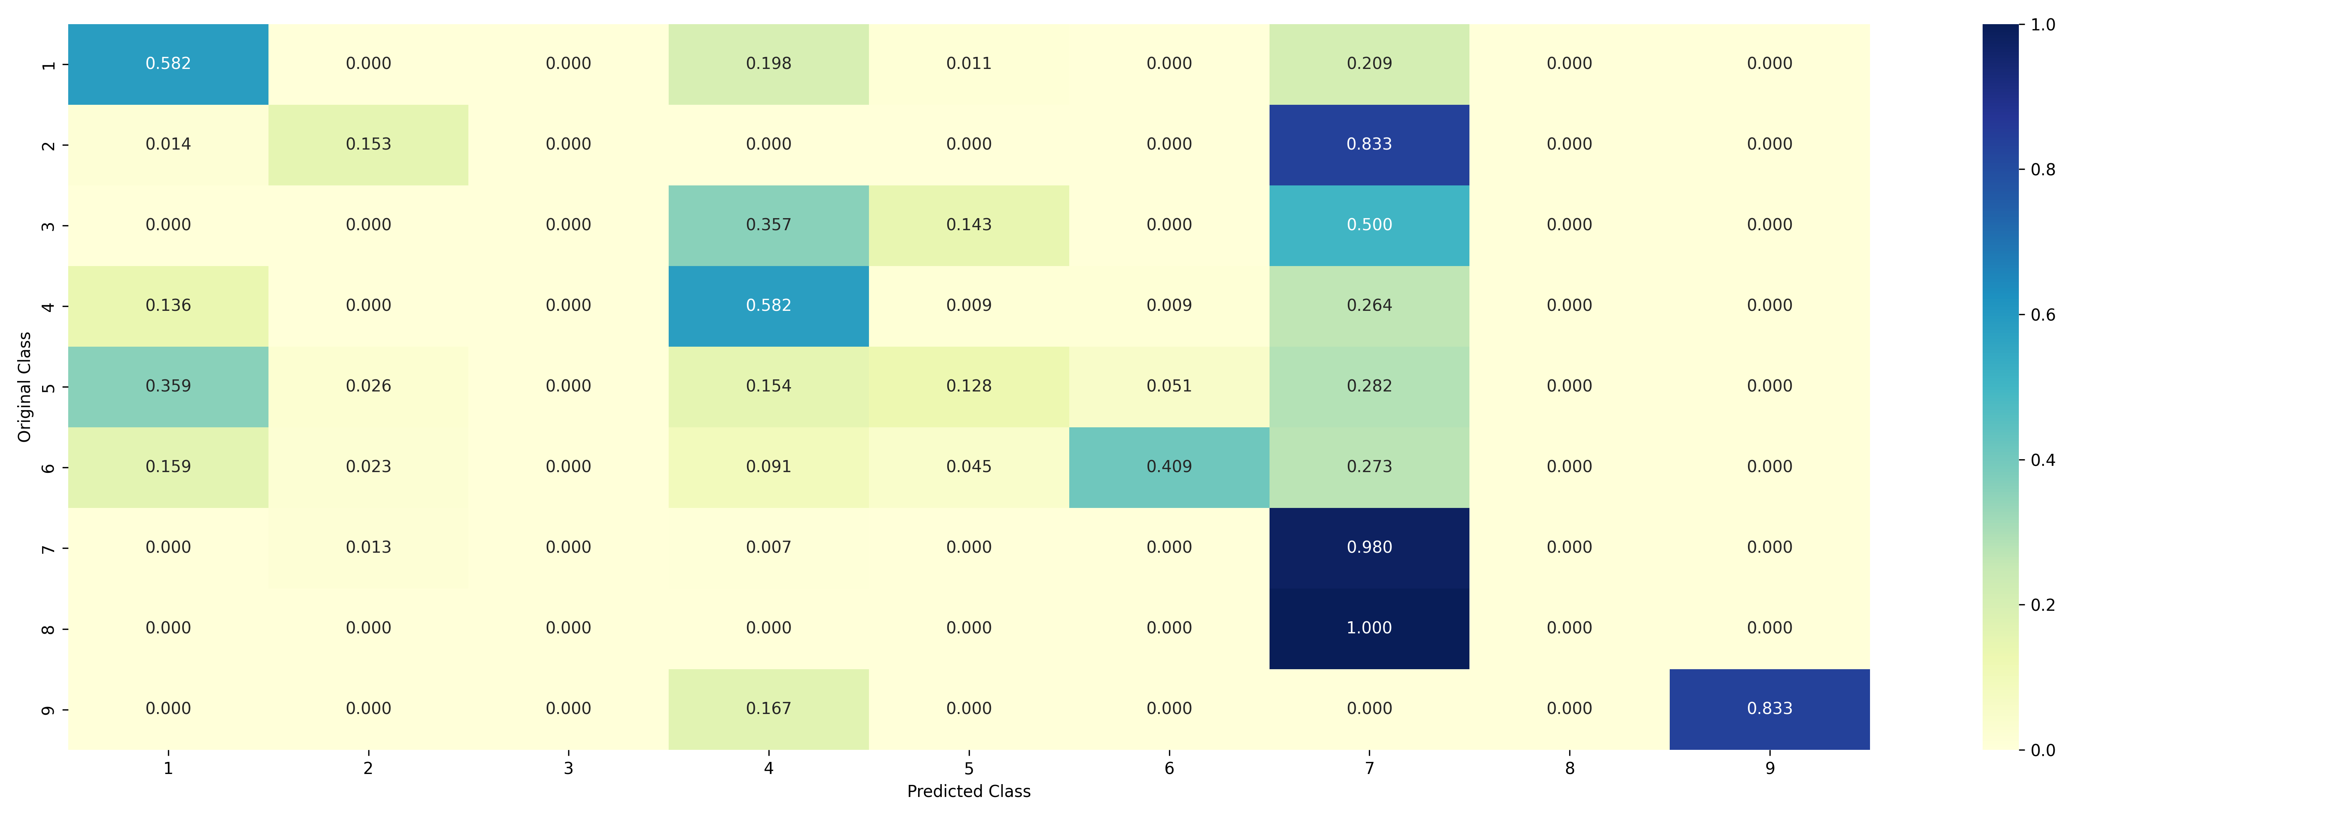
Evaluation of Naïve Bayes Model(Recall Matrix)

Slide 22
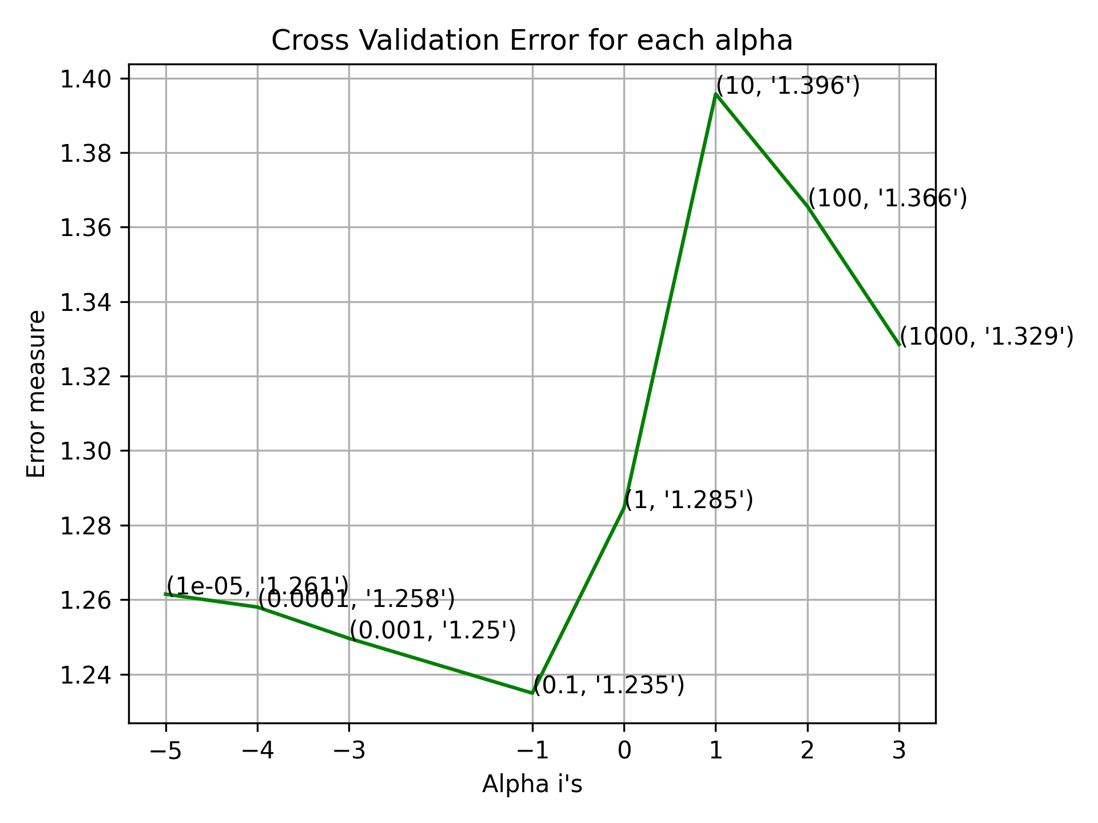
Evaluation of Naïve Bayes Model(Error Analysis)

Slide 23
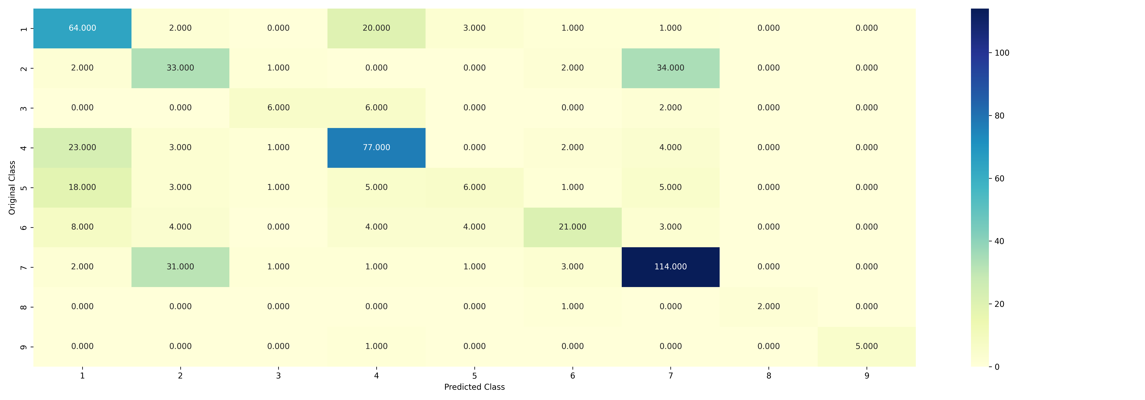
Evaluation of KNN Model(Confusion Matrix)

Slide 24
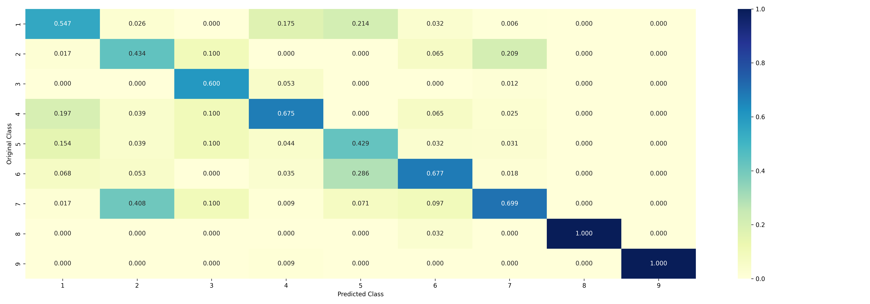
Evaluation of KNN Model(Precision Matrix)

Slide 25
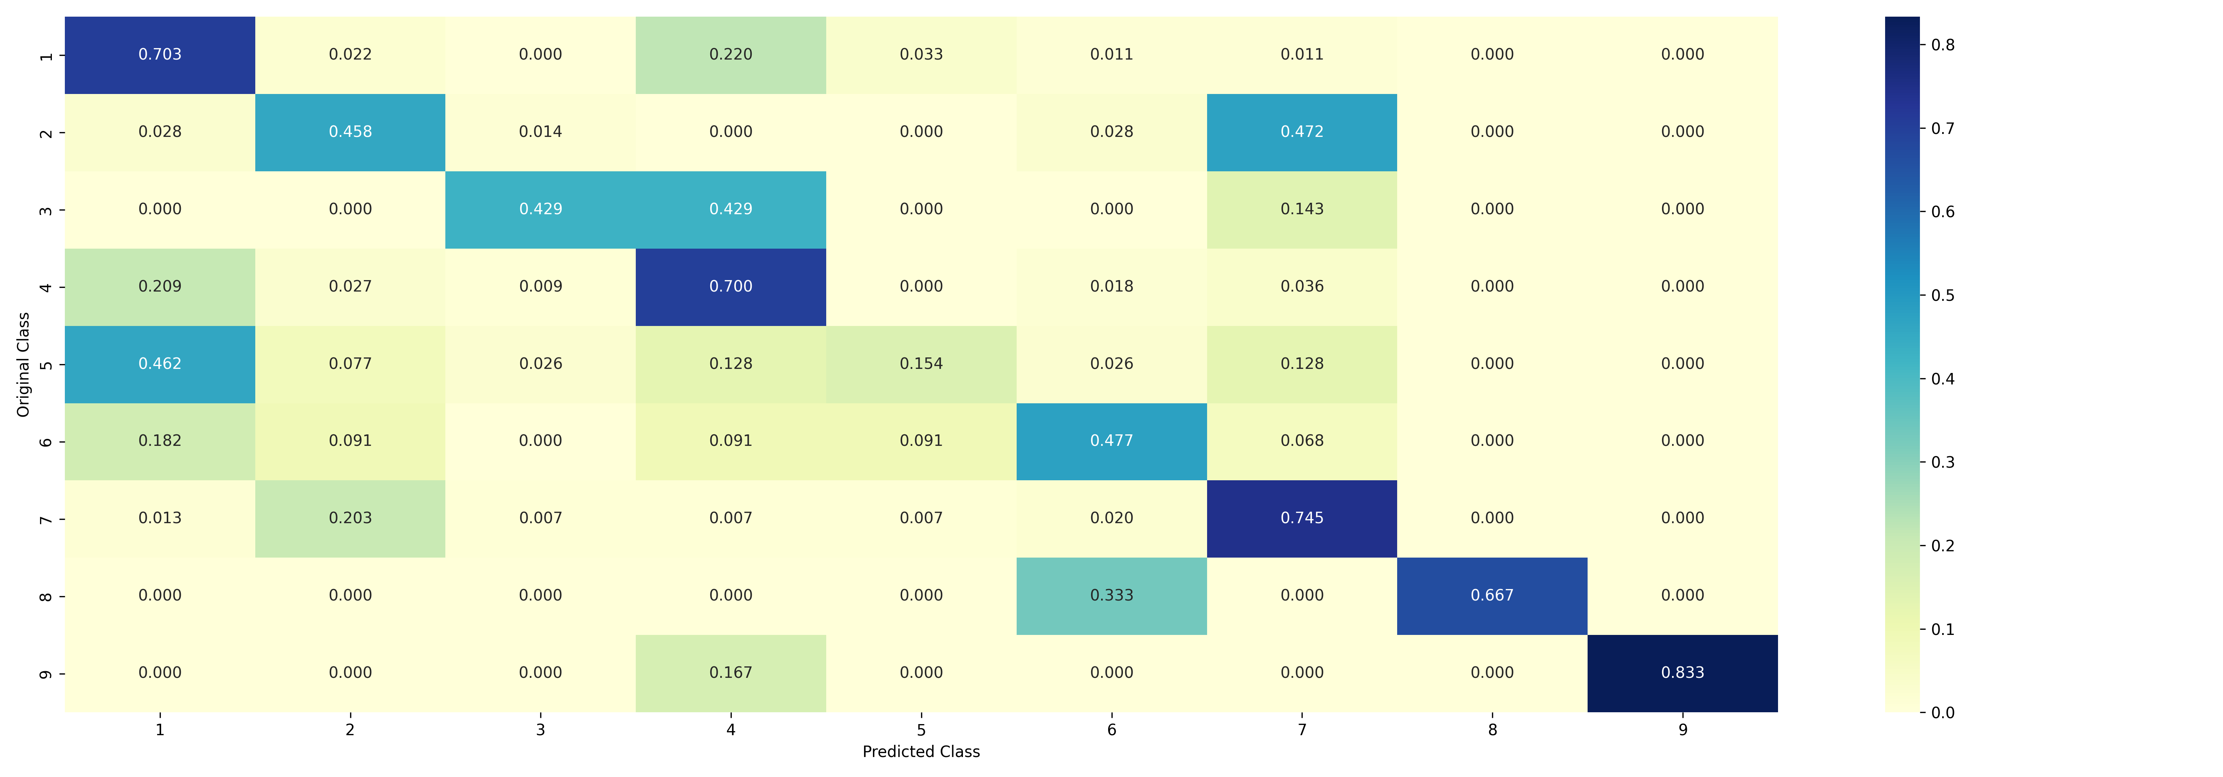
Evaluation of KNN Model(Recall Matrix)

Slide 26
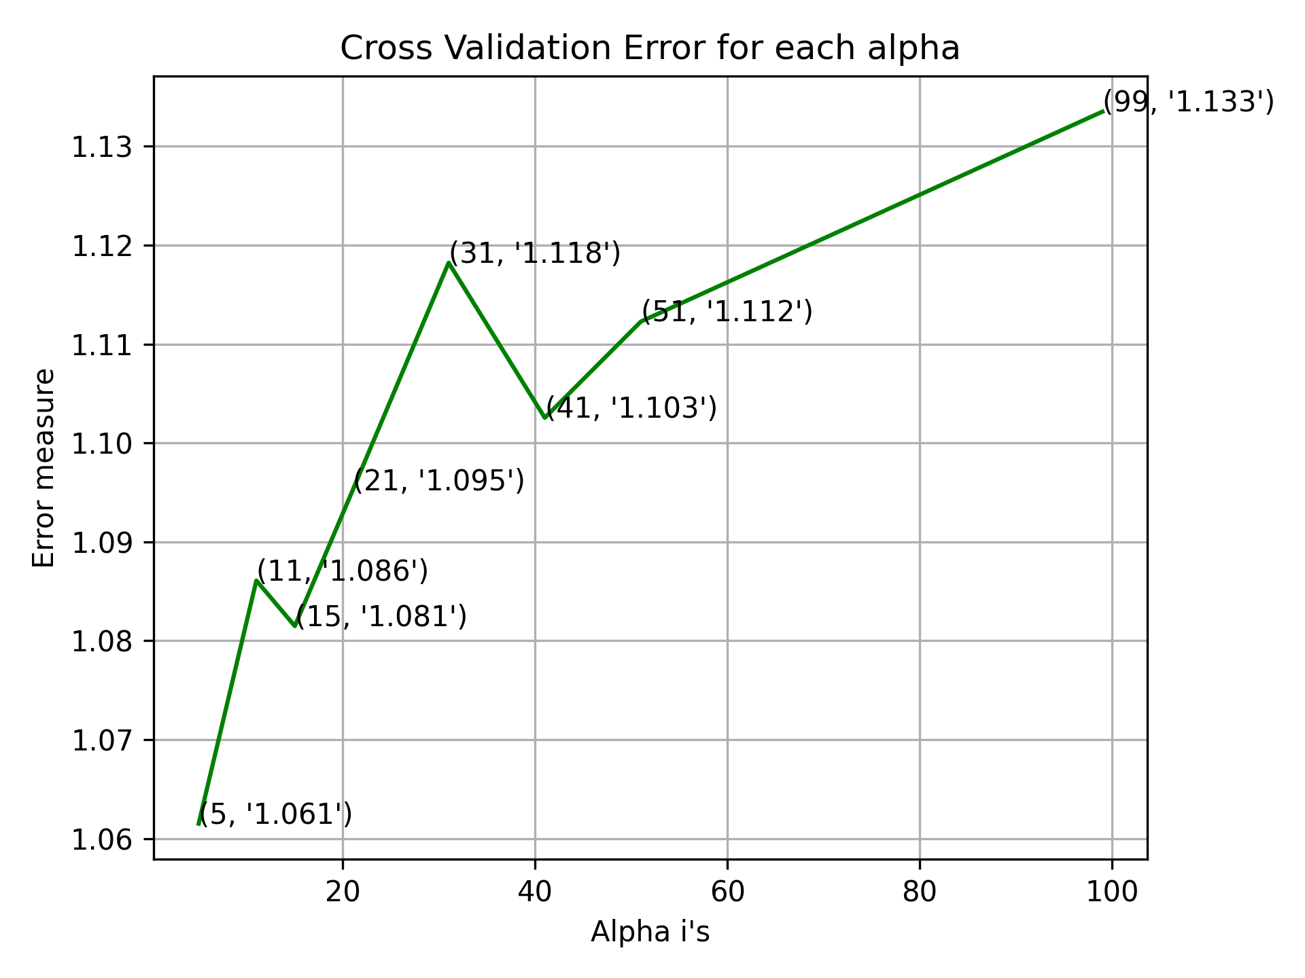
Evaluation of KNN Model(Error Analysis)

Slide 27
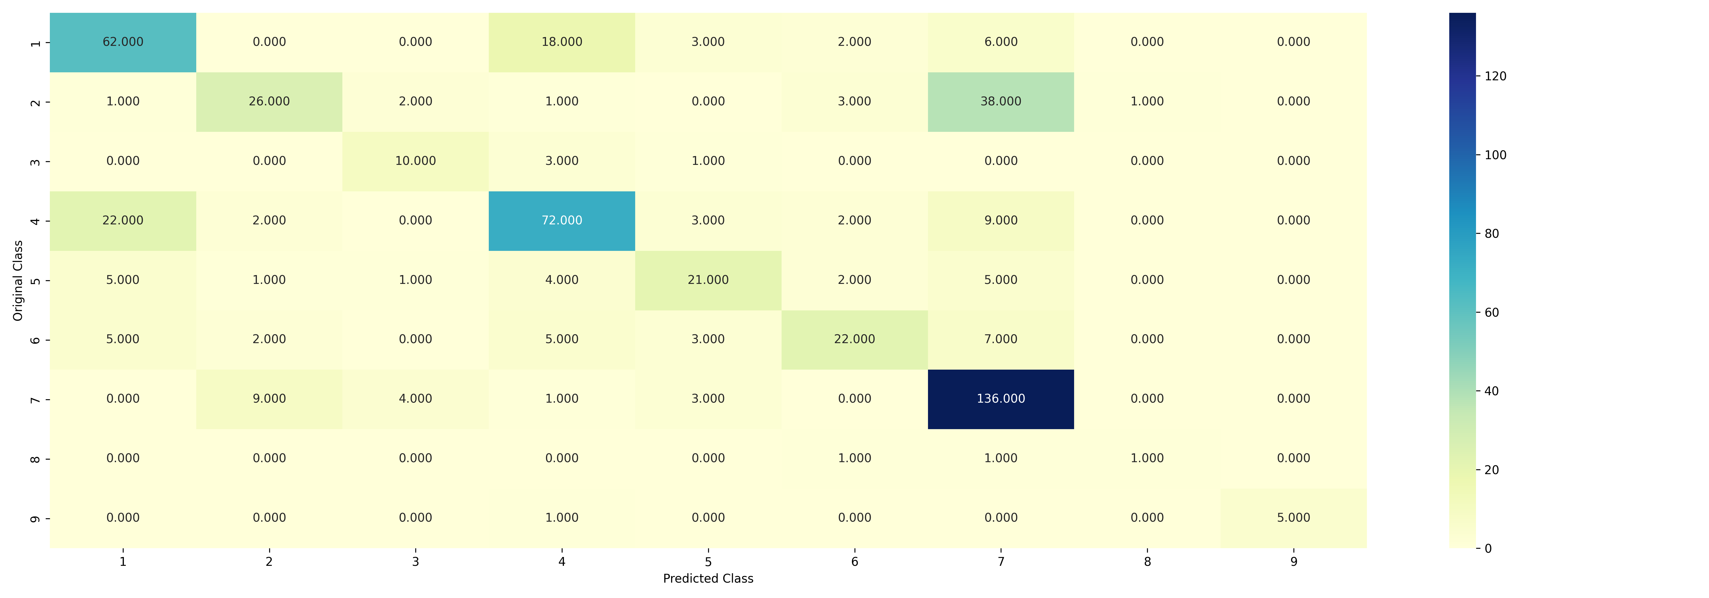
Evaluation of SVM Model(Confusion Matrix)

Slide 28
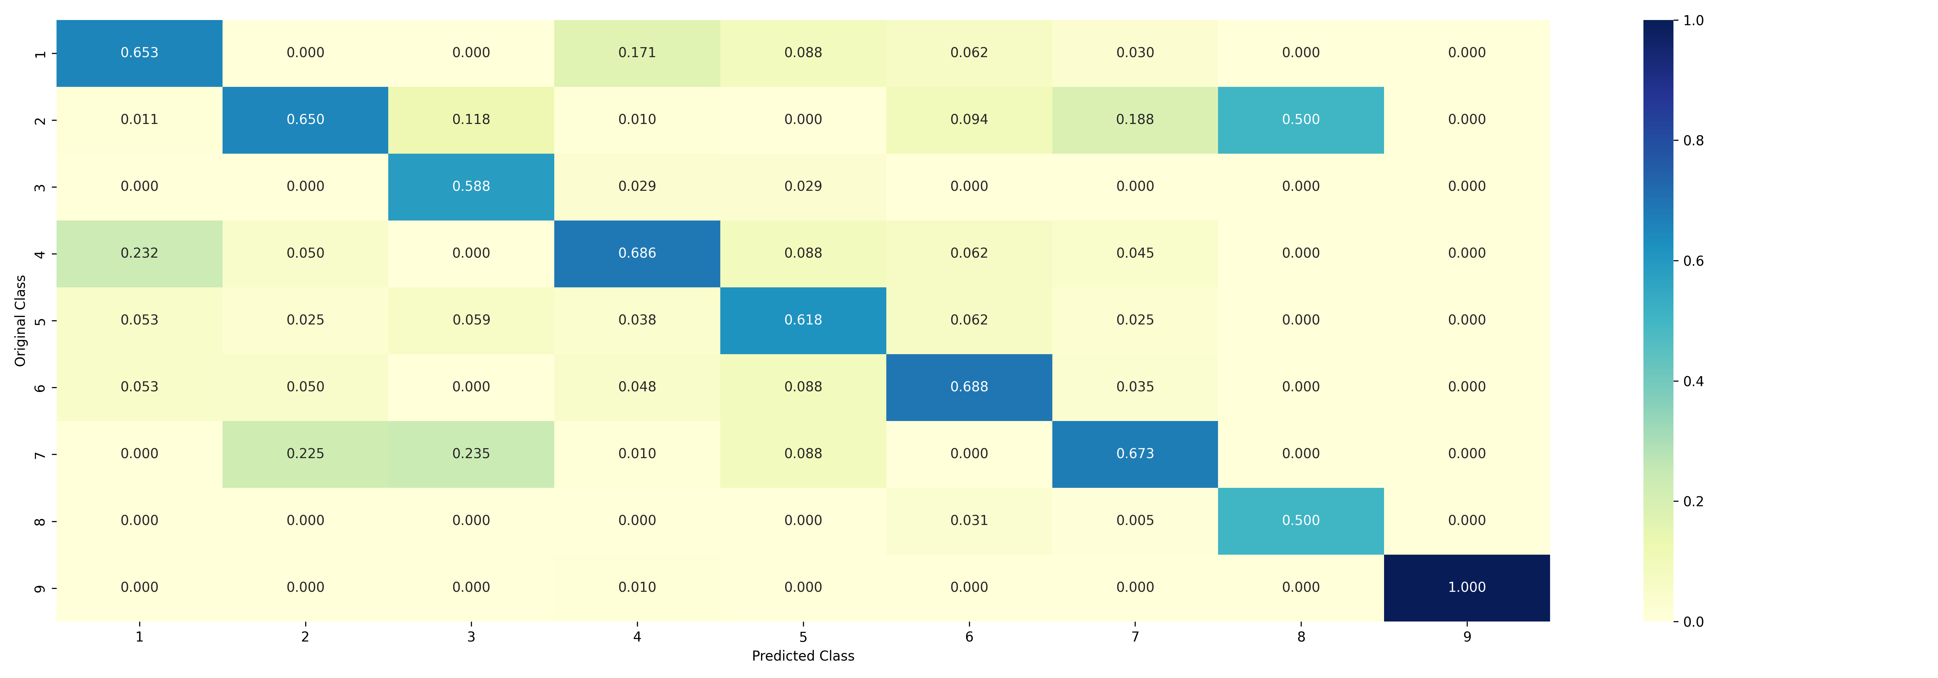
Evaluation of SVM Model(Precision Matrix)

Slide 29
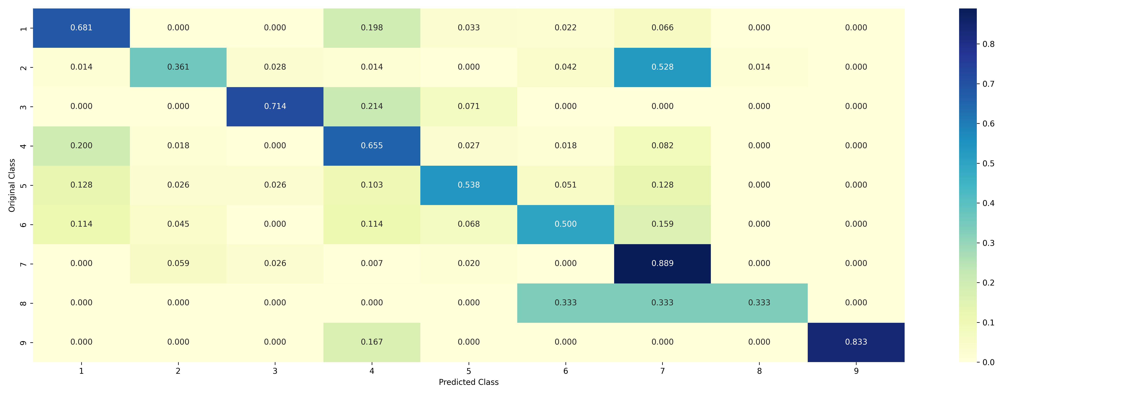
Evaluation of SVM Model(Recall Matrix)

Slide 30
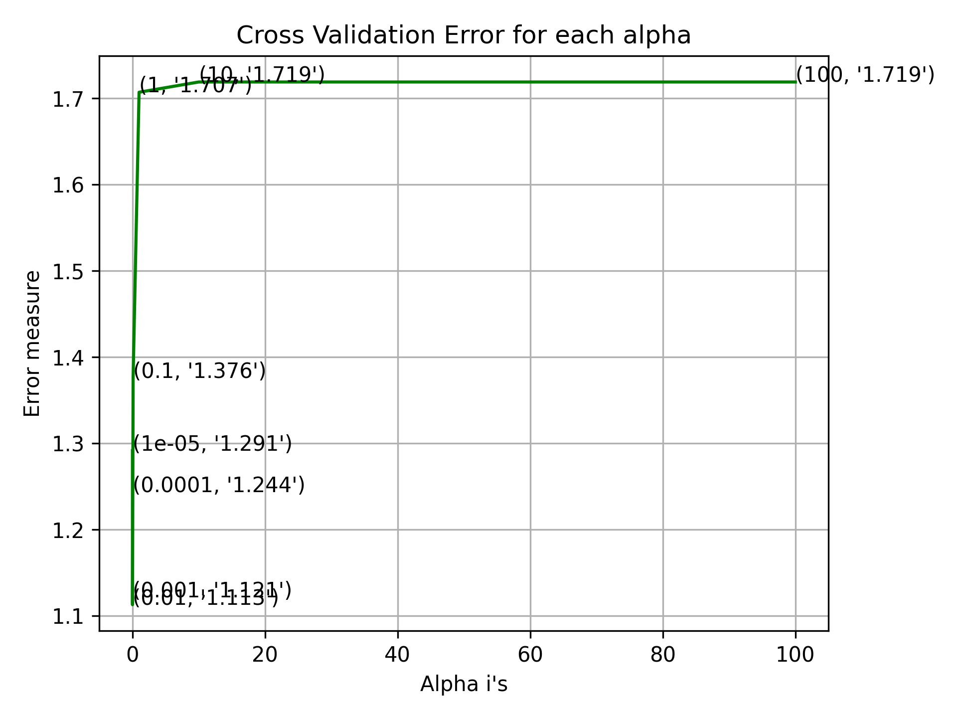
Evaluation of SVM Model(Error Analysis)

Slide 31

Evaluation of Logistic Regression Model(Confusion Matrix)

Slide 32
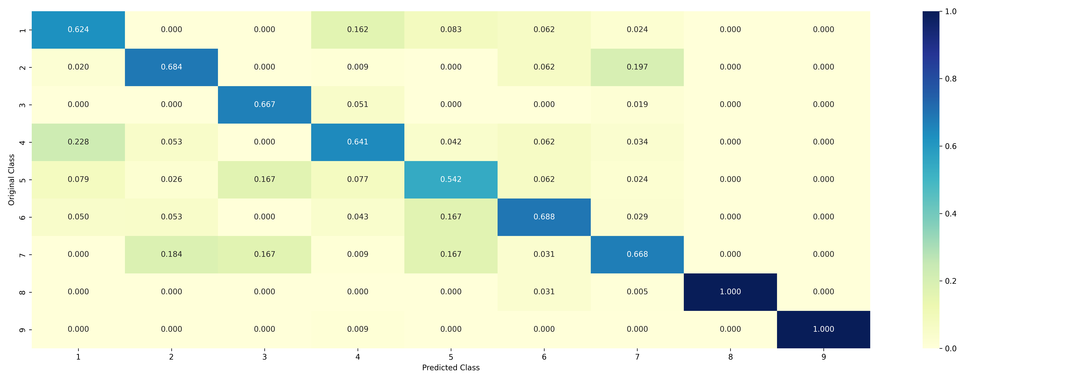
Evaluation of Logistic Regression Model(Precision Matrix)

Slide 33
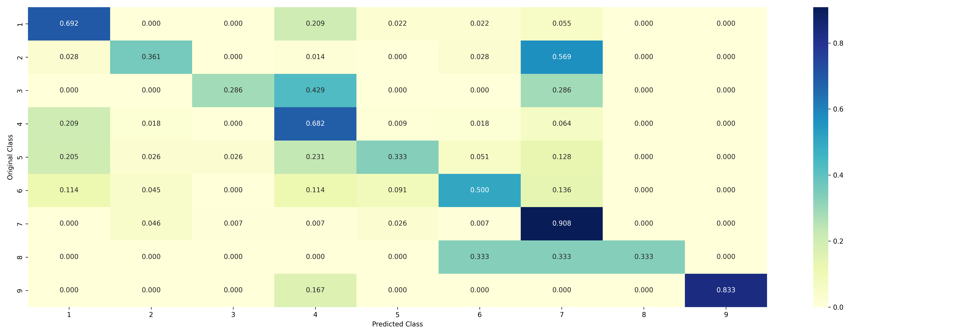
Evaluation of Logistic Regression Model(Recall Matrix)

Slide 34
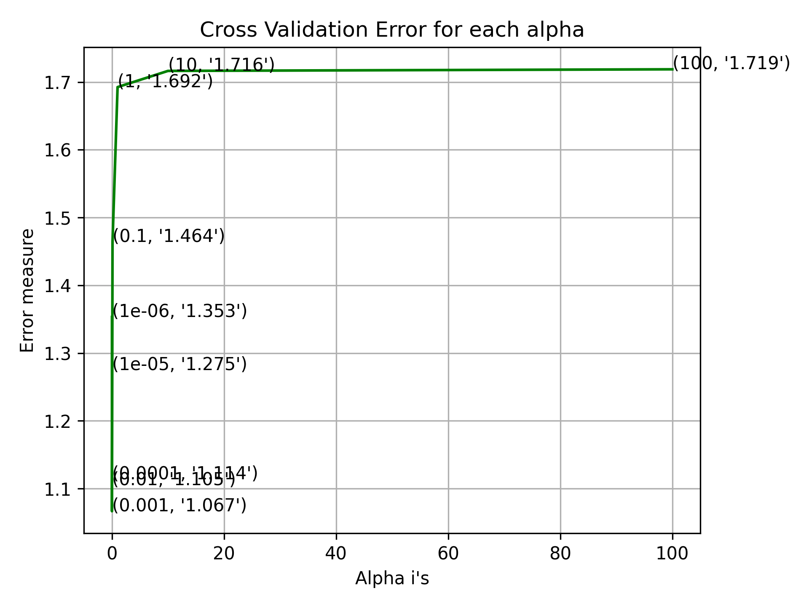
Evaluation of Logistic Regression Model(Error Analysis)

Slide 36
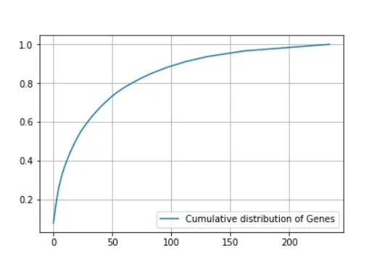
Gene Feature
Gene classification in personalized cancer diagnosis using machine learning involves training algorithms on patient genomic data to distinguish between normal and cancerous gene patterns. Features like gene expression levels, mutations, and copy number variations are used to build models. These models are then applied to new patient data to predict cancer subtypes, prognosis, and treatment responses, enabling tailored therapies for individuals based on their genetic profile.
From that we observe that there are 235 types of unique genes out of which top 50 most frequent genes nearly contribute to 75 percent of data.

Slide 37
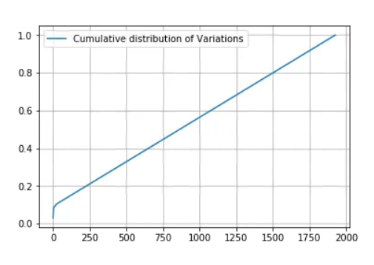
Variation Feature
Variation features in machine learning for personalized cancer diagnosis involve quantifying genetic variations like mutations, copy number alterations, and gene expression differences among patients. Algorithms analyze these features to identify patterns associated with specific cancer types or responses to treatments. By considering these variations, machine learning models can predict a patient's cancer subtype, prognosis, and recommend personalized treatment strategies, improving the accuracy and effectiveness of cancer diagnosis and care.
Here variation is also a categorical feature and we observed that 1927 unique variations out of 2124 present in training data which means most of variations occurred once or twice.

Slide 38

Text Feature
Text features in machine learning for personalized cancer diagnosis involve analyzing textual medical records, reports, and clinical notes. Natural language processing (NLP) techniques extract relevant information, such as patient histories, symptoms, and genetic test results. Machine learning models use these features to predict cancer subtypes, treatment options, and patient outcomes. By integrating textual data, healthcare providers can make more informed decisions and tailor cancer treatments to individual patients based on their unique medical narratives.

Slide 39
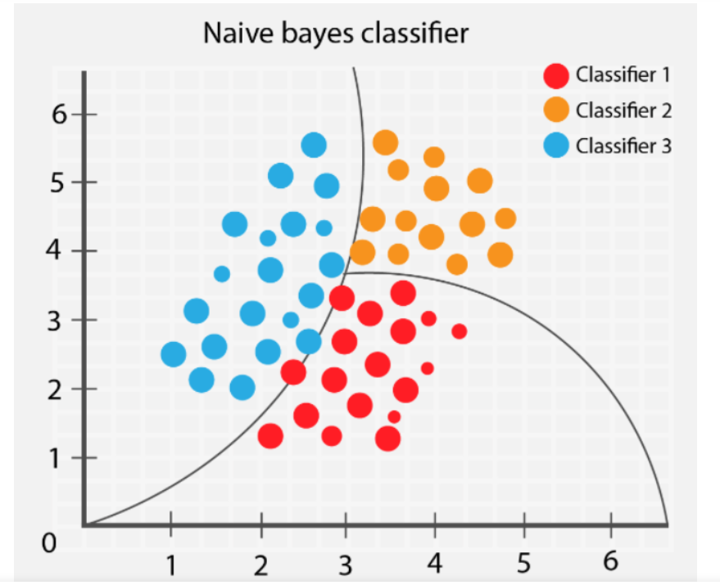
NAÏVE BAYES
Naive Bayes in personalized cancer diagnosis utilizes a probabilistic approach. It analyzes patient data, often text-based (like medical records), and calculates the likelihood of a specific cancer diagnosis based on observed word frequencies. Despite its "naive" assumption that features are independent, Naive Bayes can still provide valuable insights by estimating probabilities of various cancer types. This information aids doctors in making more informed decisions for personalized cancer treatment strategies.

Slide 40
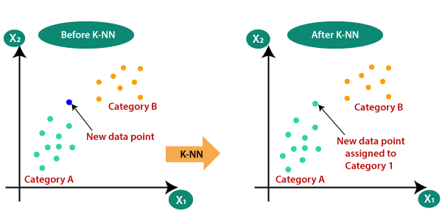
K Nearest Neighbors
K Nearest Neighbors (KNN) in personalized cancer diagnosis assigns a cancer type to a patient based on the types seen in their nearest neighbors. It measures similarity using features like gene expression or mutation patterns. If, for instance, several patients with similar genetic profiles were previously diagnosed with breast cancer, the algorithm might classify a new patient with a similar profile as having breast cancer. KNN is valuable for personalized diagnosis by considering genetic similarities among patients.

Slide 41
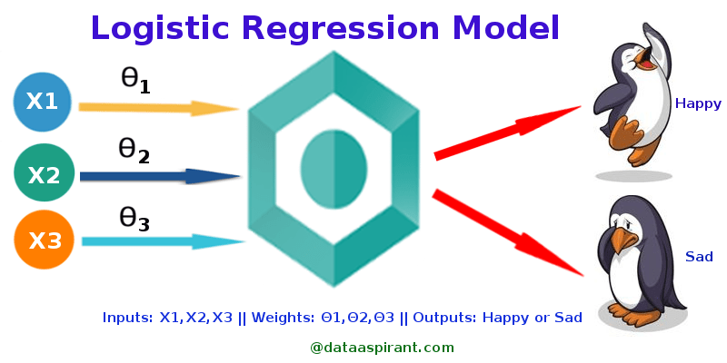
LOGISTIC REGRESSION
Logistic Regression in personalized cancer diagnosis models the probability of a patient having cancer based on input features like genetic data or clinical factors. It calculates a linear combination of these features and applies the logistic function to map the result into a probability range between 0 and 1. If the probability exceeds a certain threshold, the model predicts cancer presence. This approach helps personalize diagnosis by quantifying the likelihood of cancer based on individual patient characteristics.

Slide 42

SVM
Support Vector Machine (SVM) in personalized cancer diagnosis separates cancer and non-cancer cases by finding an optimal hyperplane that maximizes the margin between these classes in high-dimensional feature space. Genetic and clinical data are used as features. SVM identifies the most informative features for accurate classification, aiding in personalized diagnosis. It's effective for handling complex datasets, making it valuable in tailoring cancer treatment strategies based on individual patient profiles.

Slide 43
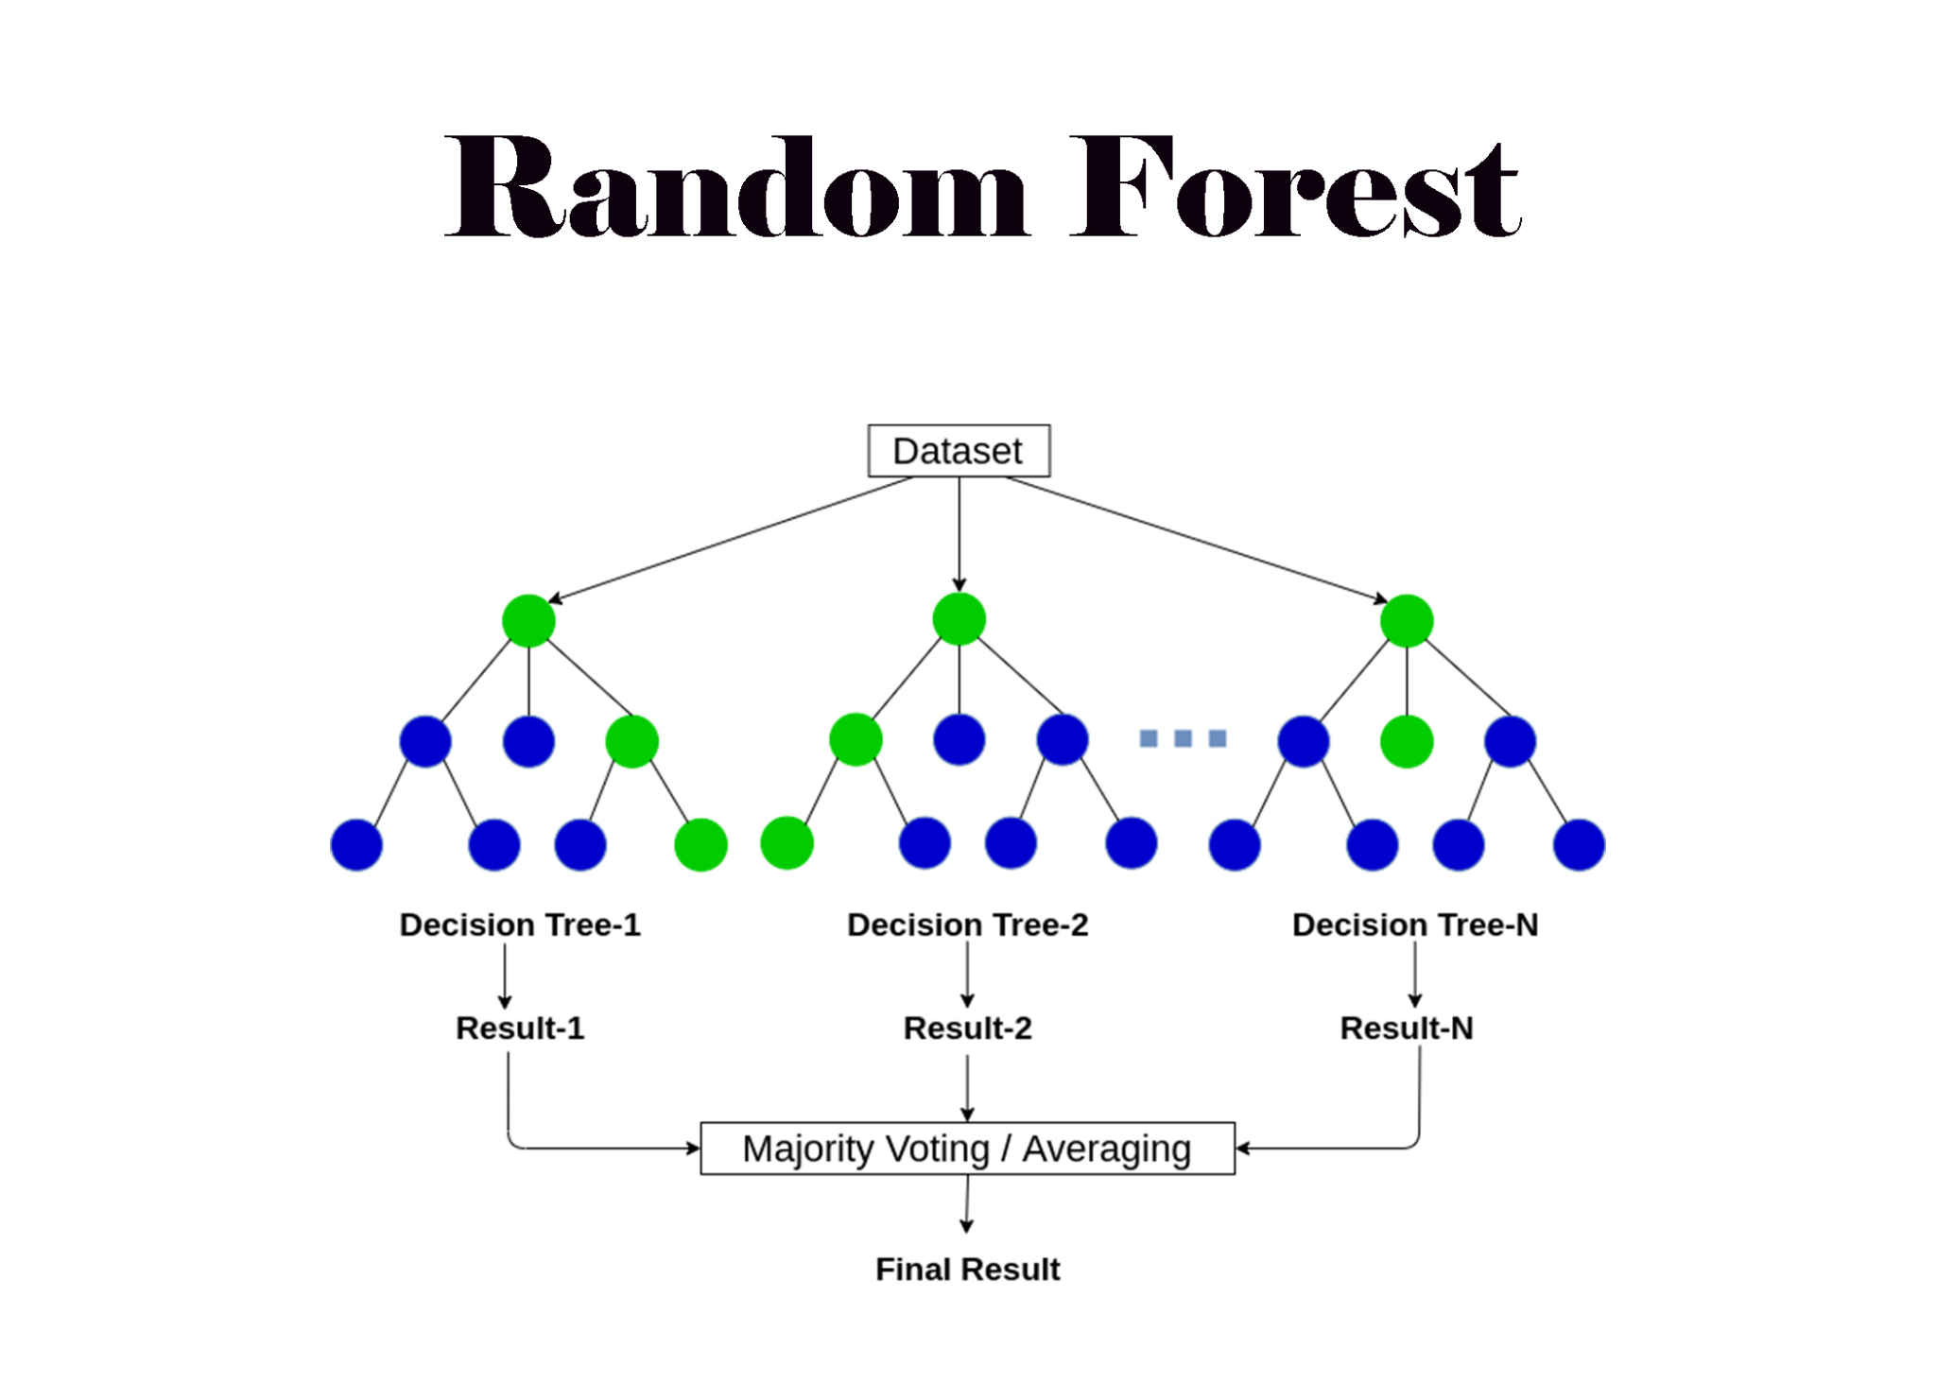
RANDOM FOREST
Random Forest in personalized cancer diagnosis is an ensemble learning technique that combines multiple decision tree models. It analyzes patient-specific genetic and clinical data to predict cancer types or treatment responses. By aggregating predictions from numerous trees, it provides robust and accurate personalized assessments. Random Forest also identifies essential features contributing to the diagnosis, aiding in the selection of tailored cancer treatment options for individual patients.

Slide 44

STACKING CLASSIFIER
Stacking Classifier in personalized cancer diagnosis is an ensemble learning technique that combines multiple machine learning models to improve prediction accuracy. It involves two levels of models: base models and a meta-model. Base models, like SVM, Logistic Regression, and Random Forest, are trained on patient data to make predictions. Then, the meta-model learns from the predictions of these base models to make a final prediction. Stacking leverages the strengths of various algorithms, enhancing the accuracy of personalized cancer diagnosis and treatment recommendations.

Slide 45

Thank You!

